Slide 1
The Modal Shop

Slide 2
Who is The Modal Shop?
Overview
Founded in 1990 in Cincinnati, Ohio as a rental services and system solution provider of PCB Piezotronics. Our team supports customers around the globe.

Slide 3
How can we help?
Our Solutions
Sound & Vibration Rental - PCB | Larson Davis | TMS Sensors and Systems
Calibration Systems – Vibration | Pressure | Acoustic for Laboratories
Portable Vibration Calibrators – Broad and Low Frequency for Field Validation
Structural Test Products – Modal & Vibration Shaker Systems | Test Accessories
Digital Sensing – Plug & Play Sensors and Signal Conditioners
Non-Destructive Testing – End-of-Production-Line Quality Inspection Systems

Slide 4
Industries Served
Test Applications
Automotive | Aerospace & Defense | Research & Development.
Industrial Applications
Energy | Oil & Gas | Power Gen
Quality Inspection
Automotive | Aerospace & Defense | Research & Development.

Slide 5
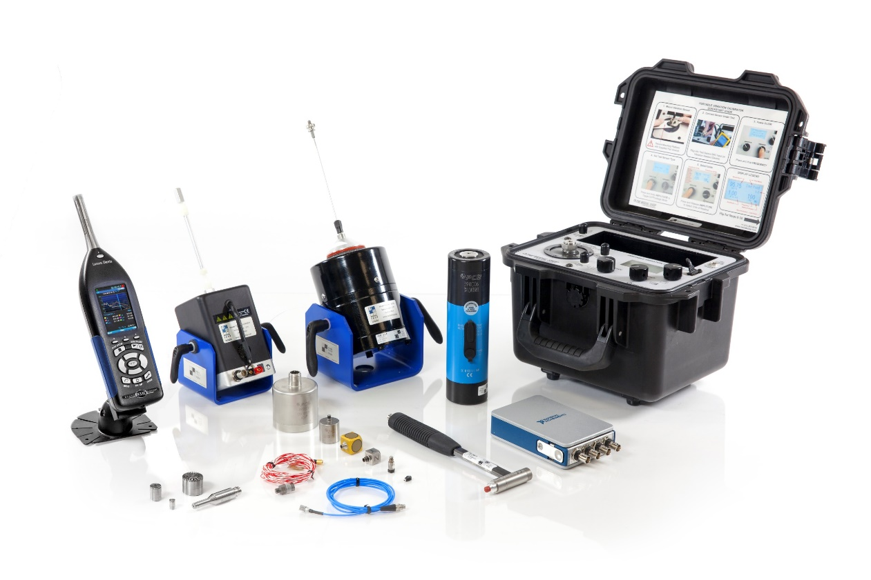
Sound & Vibration Rental
Rent World Class Products
PCB | TMS | Larson Davis | MTS | Siemens | NI | M+P | Crystal
Solutions from TMS Rental
Sensors
Accelerometers | Microphones | Pressure Sensors | Impedance Heads | Strain
Systems
Modal & Vibration Shakers | Sound Level Meters | Noise Monitoring Kits | Portable Calibrators | DAQ | Wheel Force

Slide 6
Industries & Applications
Sensors & Systems Rented Globally
Aerospace & Defense
Ex: Ground Vibration | Satellite Testing | Force Limited
Automotive
Ex: Modal Analysis | NVH Testing | Wheel Force
Test & Measurement
Ex: Research & Development | Consumer Goods
Environmental Noise Monitoring
Noise & Vibration Industrial Hygiene

Slide 7
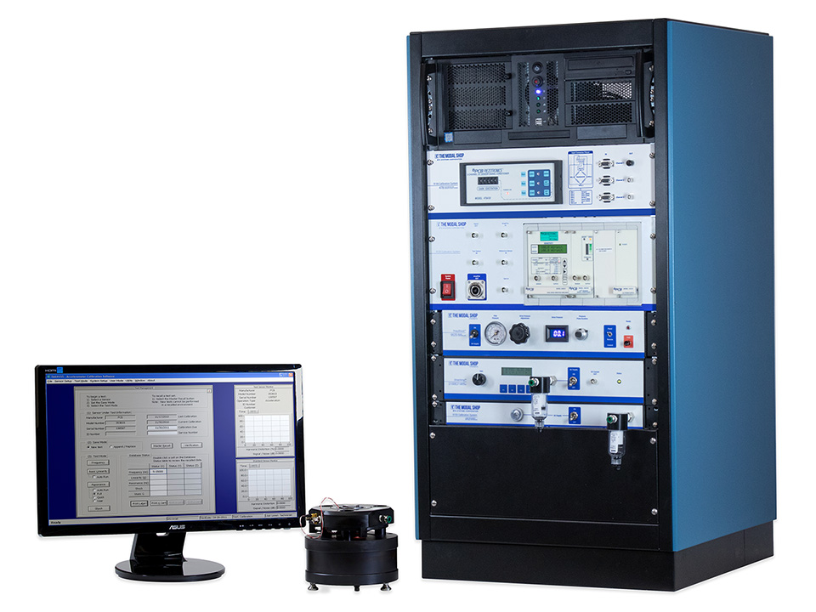
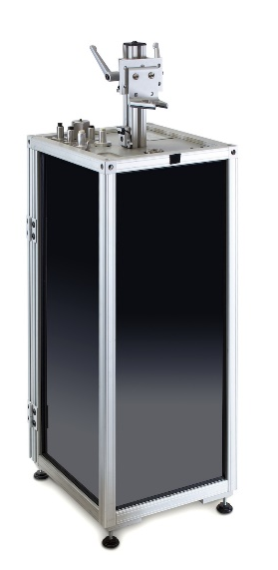
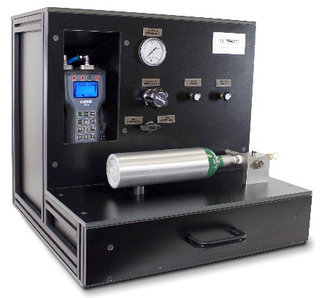
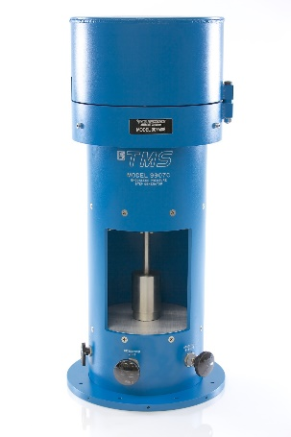
Calibration Systems
Precision, Reliability, Usability
Laboratory Calibration Systems
For Your Sensors
Vibration & Shock
Acoustic
Dynamic Pressure
Turn-key Experience
Installation and Training Services
Ongoing Maintenance and Support

Slide 8
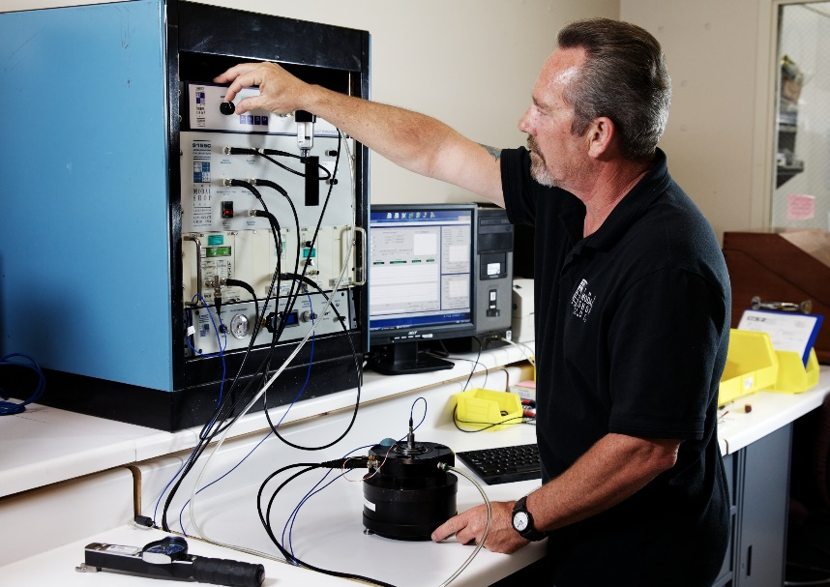
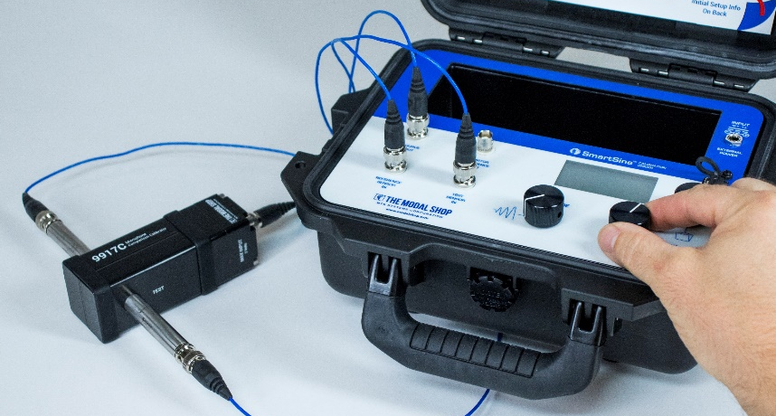
Industries & Applications
World Class Metrology
Aerospace & Defense
Automotive
Test & Measurement
Energy & Power Generation
Regional Metrology Service Providers
National Metrology & Primary Laboratories

Slide 9
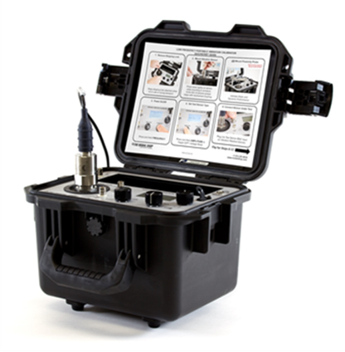
Portable Vibration Calibration
Promote Safety, Reduce Downtime
Broad (5 Hz - 10 kHz) & Low Frequency (0.7 Hz - 2 kHz) Units
Field Validation of Sensors
Accelerometers
4-20 mA Loop Vibration Transmitters
Velocity Sensors
Proximity Probes
Electronic Vibration Switches
PLC, DCS, SCADA Alerts & Alarms
Vibration Analyzers

Slide 10
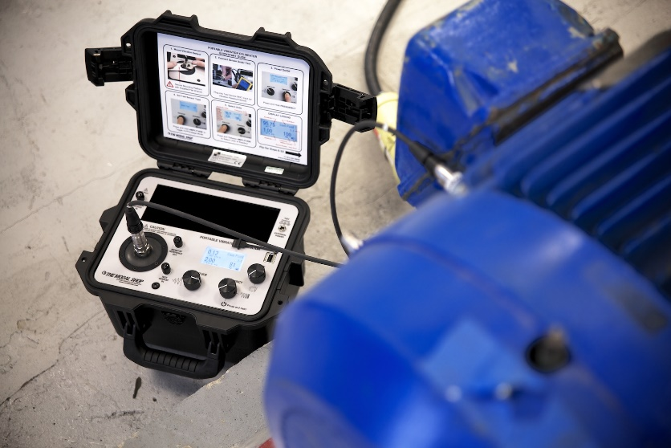
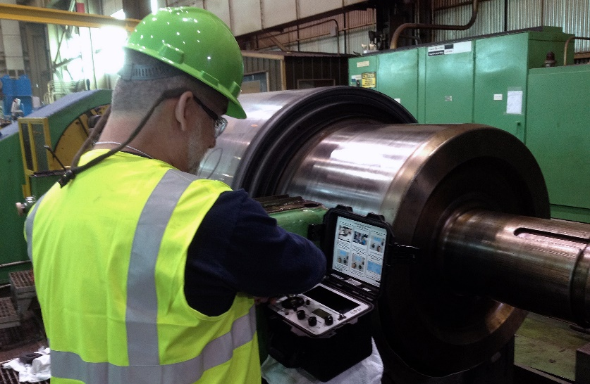
Industries & Applications
Power Generation
Refineries
Pipelines
Chemical
Mining
Pharmaceutical
Military
Automotive
General Manufacturing

Slide 11
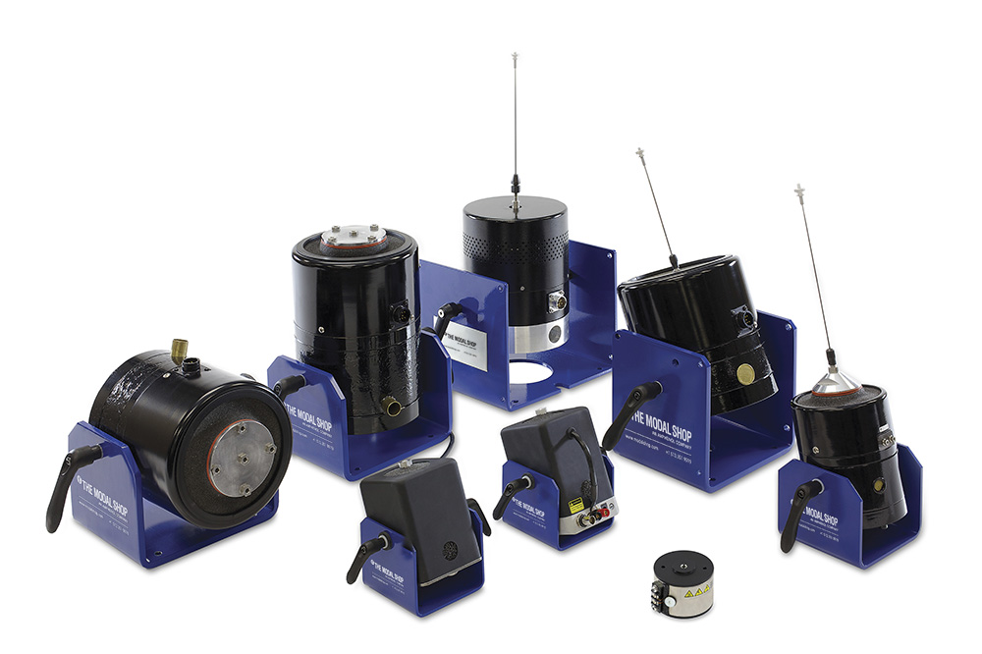
Structural Test Products
Complete Shaker Systems
Electrodynamic Exciter Kits from 9 N to 489 N
Variety of Options
Modal Shakers
Dual Purpose Shakers
Mini Shakers
Inertial Shakers
Test Accessories
PCB Sensors
AirRide Supports | Shaker Stands

Slide 12
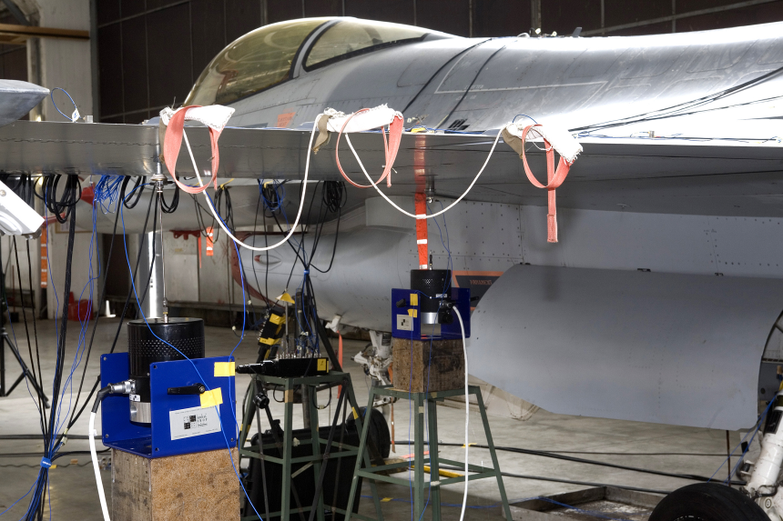
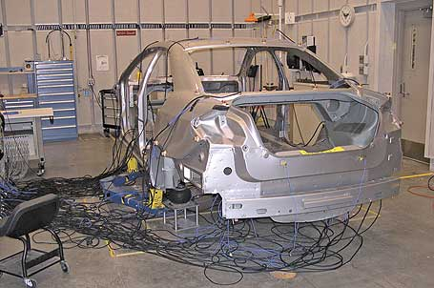
Industries & Applications
Solutions for Testing
Automotive
Ex. NVH | General Vibration Testing
Aerospace & Defense
Ex. Ground Vibration Testing
Research & Development
Consumer Products
Medical
Universities
Ex. Teaching | R&D

Slide 13
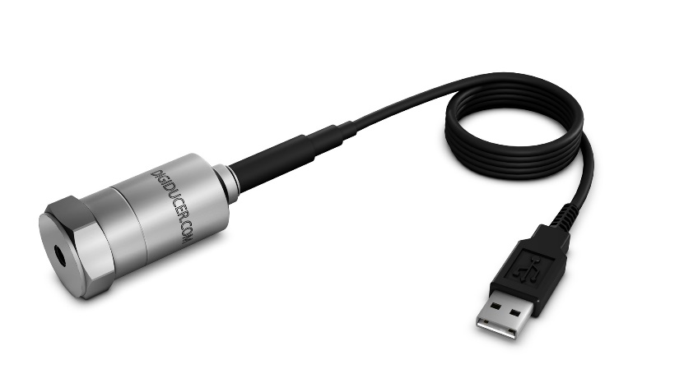
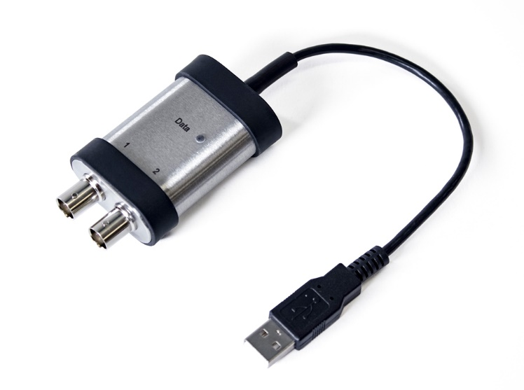
Digital Sensing
Plug & Play Solutions
Making high quality measurements accessible
Digiducer USB Accelerometer
Broad frequency Piezoelectric sensor
Record real-time data via smartphone, tablet, PC
ICP® to USB Signal Conditioner
Pocket-sized, portable sensor digitization compatible with existing ICP Sensors
Easy data collection and sharing

Slide 14
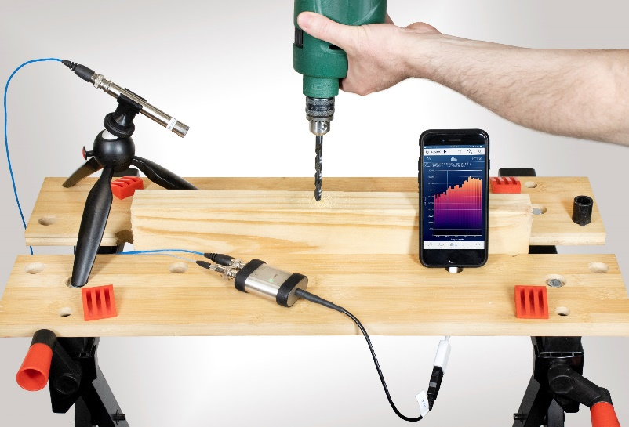
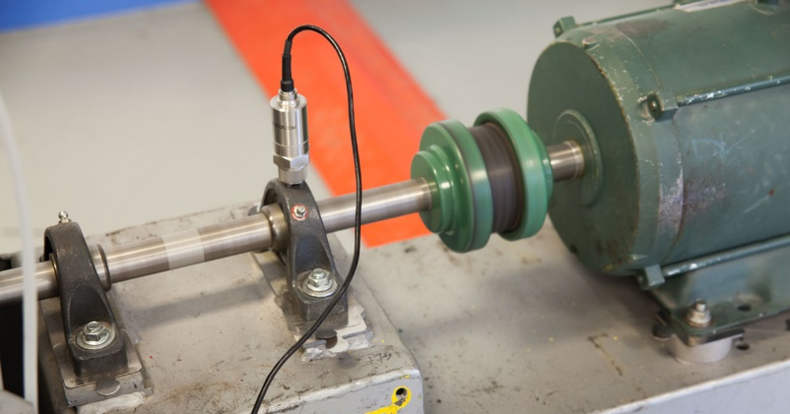
Industries & Applications
From Test to Industrial
Aerospace & Defense
Consumer Products
Electronics & Communication
Noise & Control Engineering
Industrial & Process Manufacturing
Research & Development
Universities

Slide 15
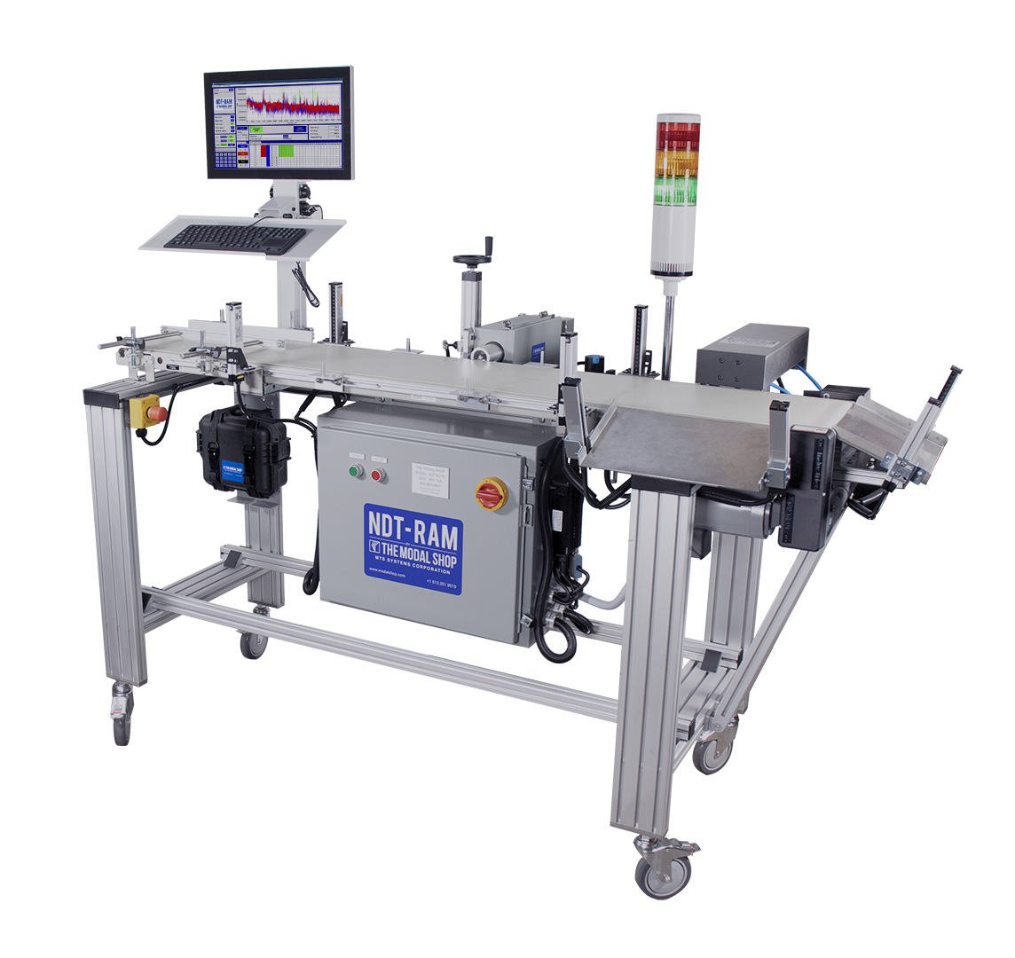
Non-Destructive Test Systems
100% Quality Inspection of Metal Parts
NDT-Resonant Acoustic Method
Fast, Objective Results
Systems for Production Line Integration
From NDT-AUTO for larger parts to NDT-Drop Fixture for small components
Results as fast as 3 seconds per part
Simple Pass / Fail Result
No interpretation needed

Slide 16
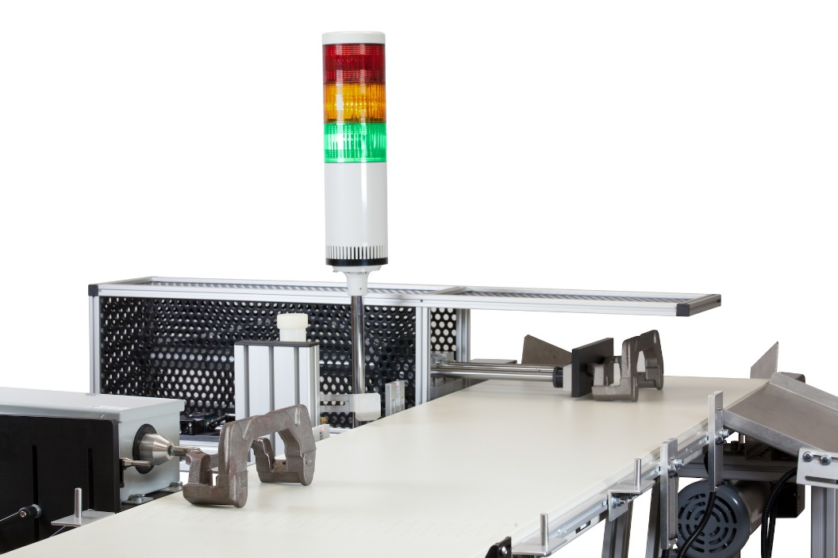
Industries & Applications
Bring 100% Quality Around the World
Automotive
Aerospace & Defense
For Manufacturing of Parts
Powdered Metal
Ductile Iron
Bearings
Castings
Forgings
Additive Manufacturing

Slide 17
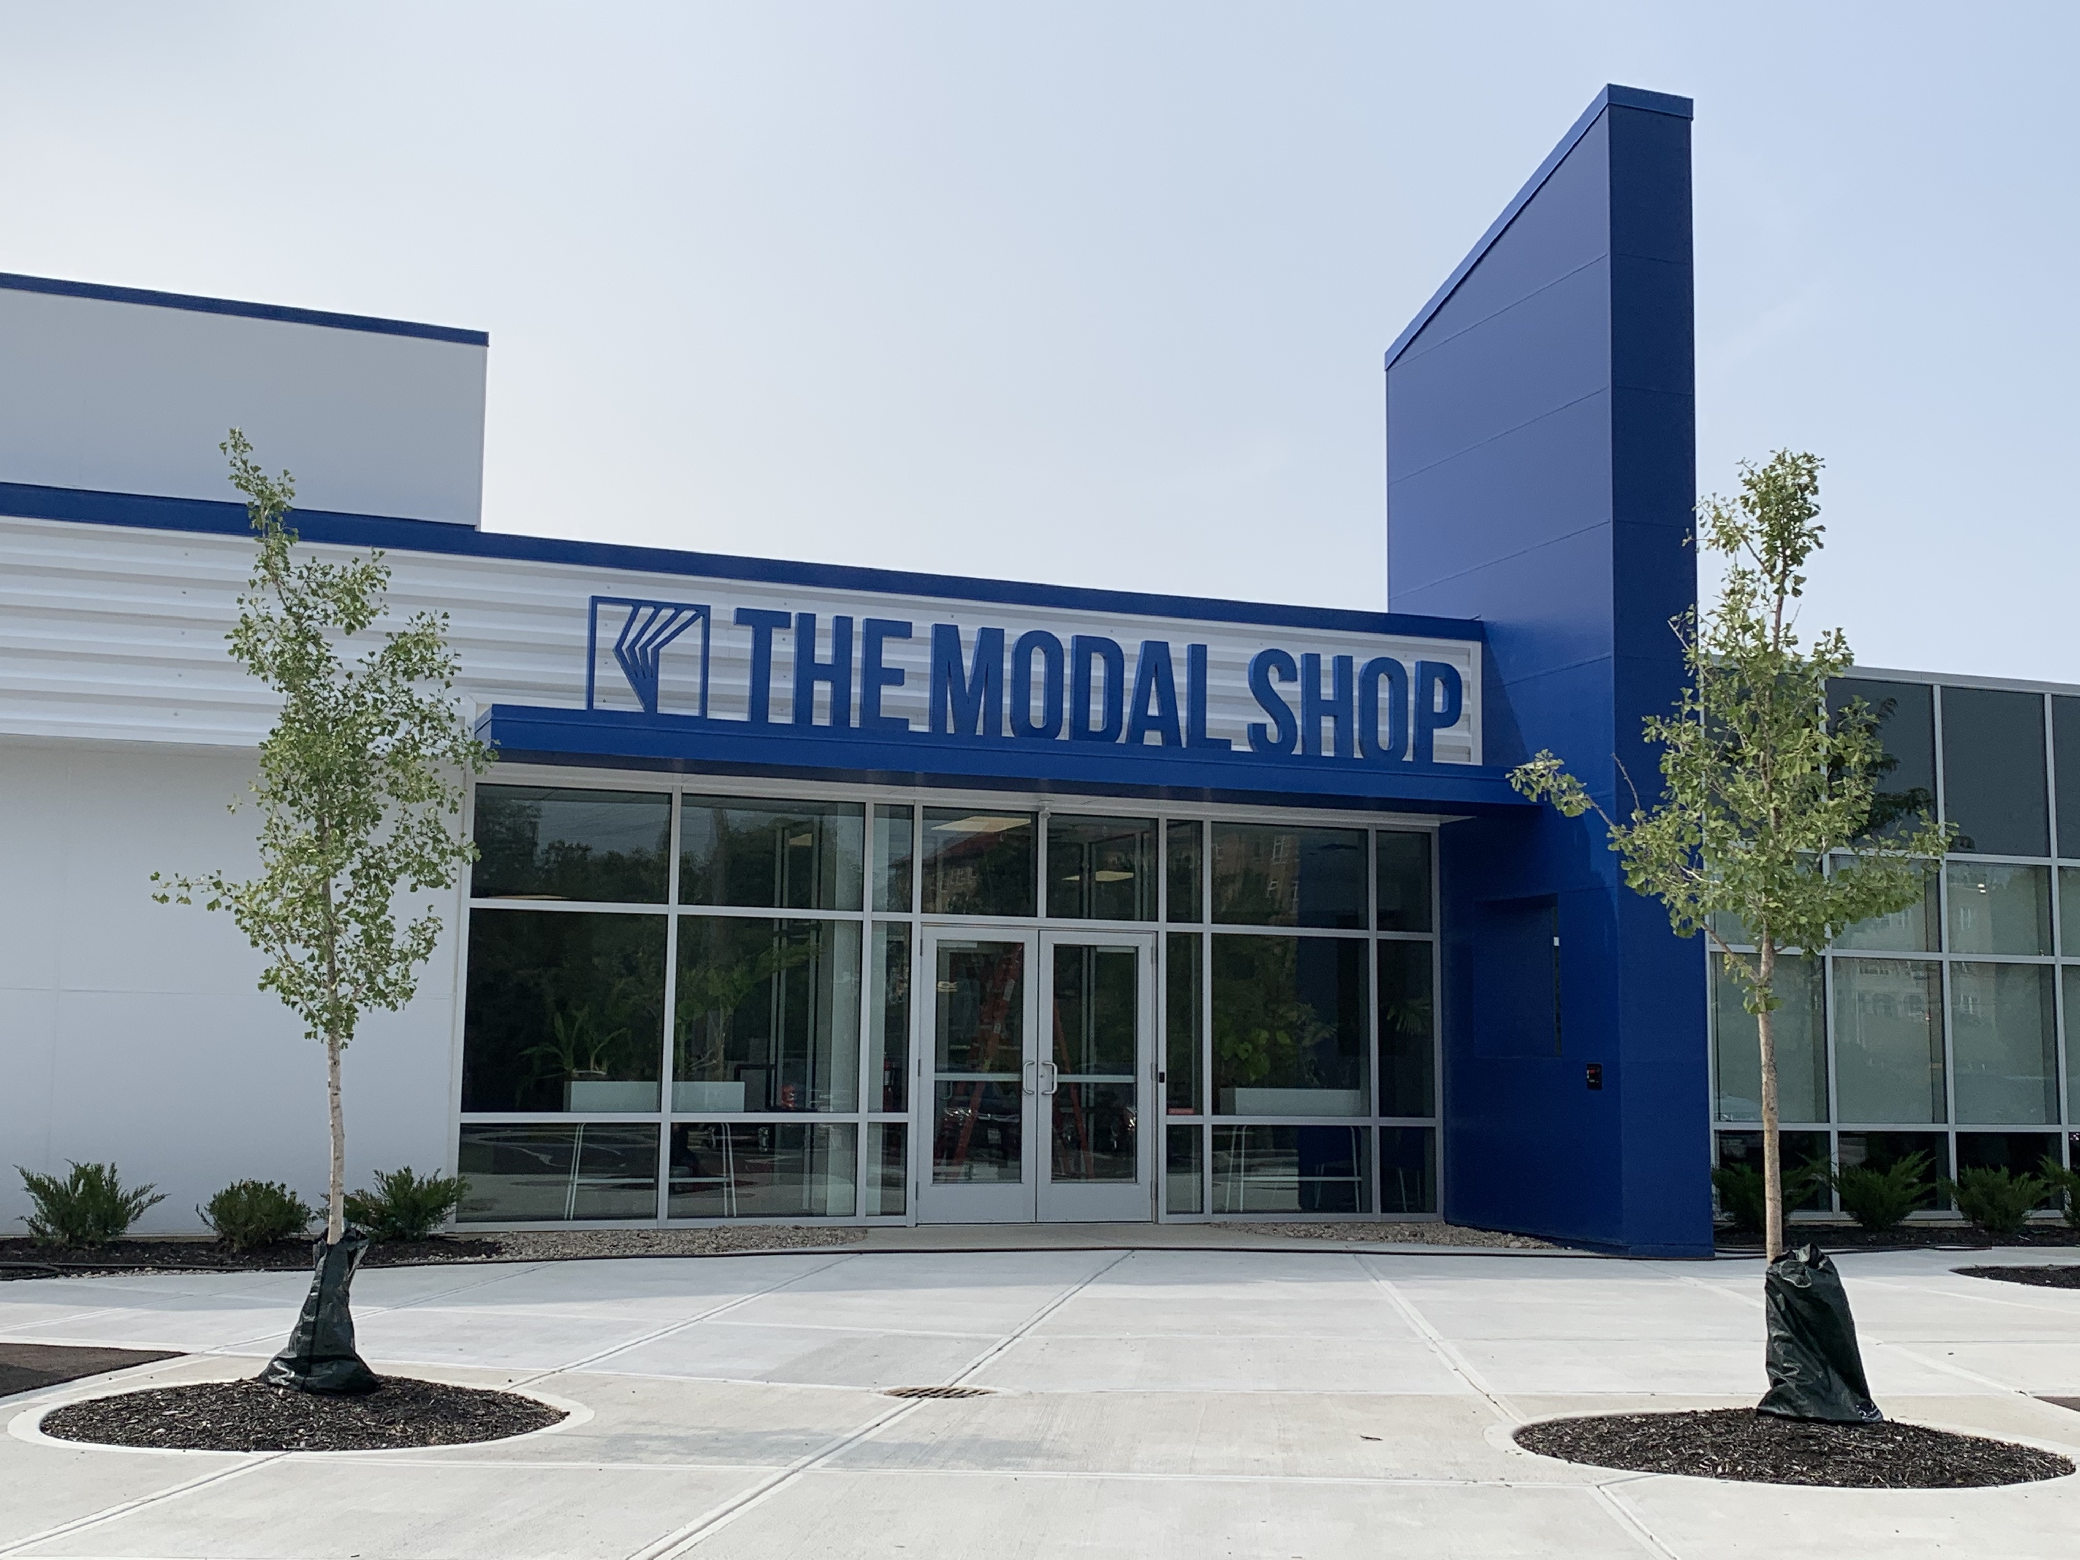
Thank You

